Slide 1
Sparse Tensor Core: Algorithm and Hardware Co-Design for Vector-wise Sparse Neural Networks on Modern GPUs
Maohua Zhu∗. Micro 2019

Slide 2
背景：
稀疏性
the intrinsic redundancy in the weights of neural
top-K sparsifying and retraining could result in more than 90% sparsity
目前利用的方式
state-of-the-art sparse library,CUSPARSE, encodes a sparse weight matrix to CSR. top-K sparsifying has a random number of non-zero elements in a row, the CSR format often leads to poor workload balance.
Tensor Core has been introduced in Volta architecture [53] to provide 8× peak TFLOPs than the FP32 CUDA Core (112TFLOPs v.s. 14TFLOPs).
Unfortunately, Tensor Core focuses only on the acceleration of dense matrix multiplication. Sincesparse GEMM cannot take advantage of Tensor Core, we haveseen little speedup when running sparse neural networks by top-Ksparsifying on it. 结构化稀疏带来精度的降低。

Slide 3
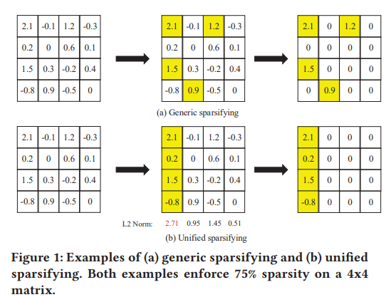
背景：
generic sparsifying 、 unified sparsifying
Although the generic sparsifying achieves a very high compression ratio, it exposes several inefficiencies on GPUs [66]. Firstly, the variation of the row/column length of a generic sparse matrix makes it difficult to partition the workload evenly into GPUs [43]. Secondly, the number of non-zero elements in each row is unknown until runtime, leaving it difficult to choose an optimal tiling scheme for data reuse. Thirdly, the computation amount of a highly sparse matrix is not enough to hide the long memory access latency, and therefore the benefit from the high sparsity vanishes

Slide 4
动机：解决稀疏在tensorcore上的表现

Slide 5
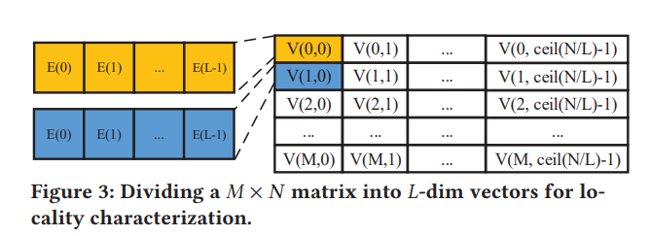
Vector-wise
考虑二阶梯度后，提出了AdaHessian算法

Slide 6
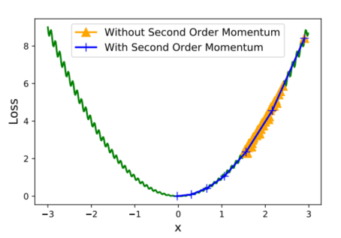
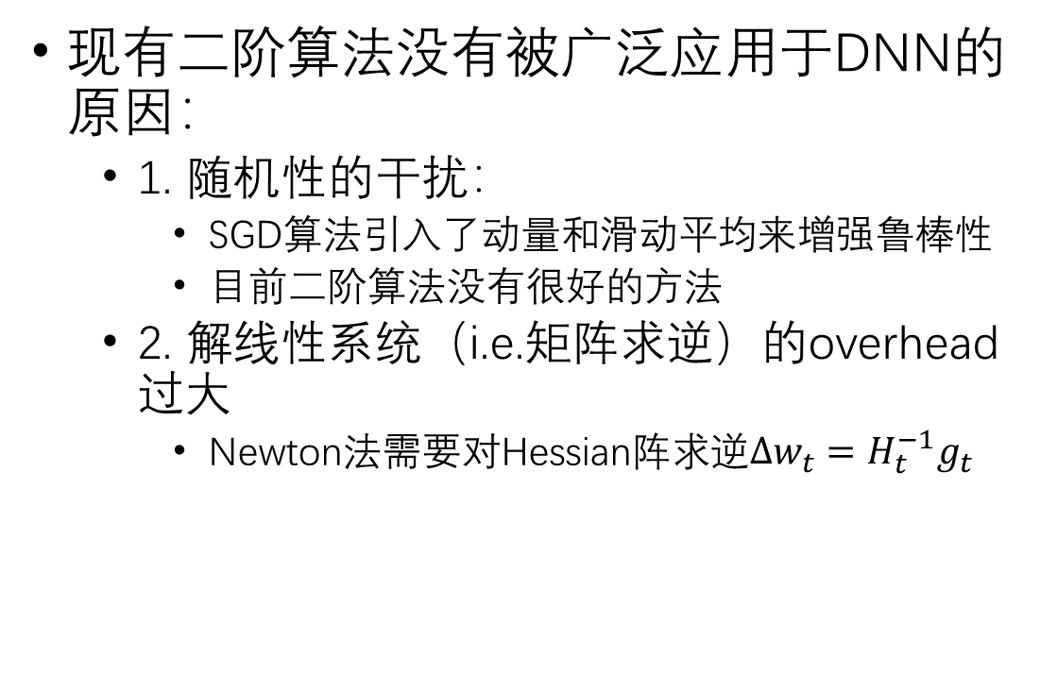
二阶优化算法的挑战
现有二阶算法没有被广泛应用于DNN的原因：
1. 随机性的干扰：
SGD算法引入了动量和滑动平均来增强鲁棒性
目前二阶算法没有很好的方法
2. 解线性系统（i.e.矩阵求逆）的overhead过大
Newton法需要对Hessian阵求逆$Δw_{t}=H_{t}^{−1}g_{t}$

Slide 7
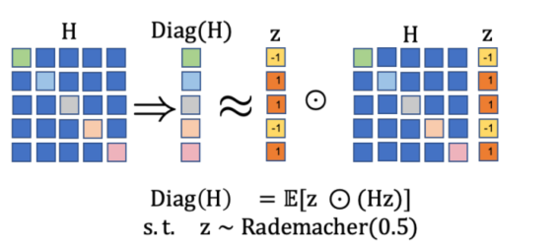
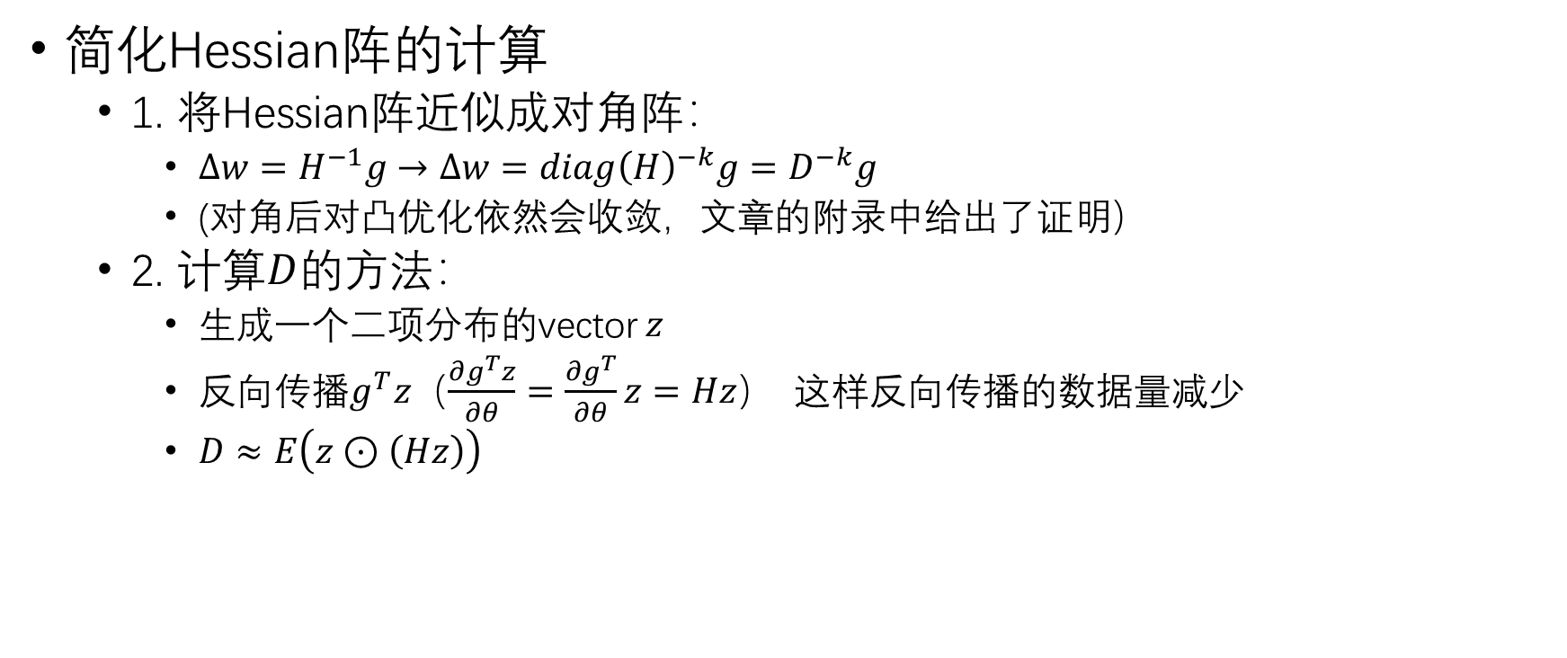
ADAHESSIAN（一）
简化Hessian阵的计算
1. 将Hessian阵近似成对角阵：
$Δw=H^{−1}g→Δw=diag{\left(H\right)}^{−k}g=D^{−k}g$
(对角后对凸优化依然会收敛，文章的附录中给出了证明）
2. 计算$D$的方法：
生成一个二项分布的vector $z$
反向传播$g^{T}z$（$\frac{∂g^{T}z}{∂θ}=\frac{∂g^{T}}{∂θ}z=Hz$） 这样反向传播的数据量减少
$D≈E\left(z⊙\left(Hz\right)\right)$

Slide 8
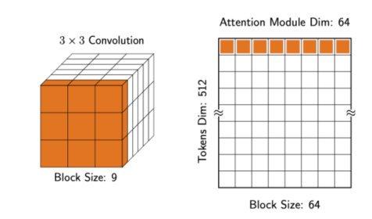

ADAHESSIAN（二）
Spatial Averaging：针对空间的随机性的干扰
$D^{s}\left[ib+j\right]=\sum_{k=1}^{b}{D\left[ib+k\right]}/b$，for $1≤j≤b,0≤i≤d/b−1$
如卷积层：将$D$在channel $1\sim b$，$(b+1)\sim 2b$ …的kernel间分别取平均

Slide 9

ADAHESSIAN（三）
动量：针对iteration间的随机性的干扰
${\overline{D}}_{t}=\sqrt{\frac{\left(1−β_{2}\right)\sum_{i=1}^{t}{β_{2}^{t−i}D_{i}^{\left(s\right)}D_{i}^{\left(s\right)}}}{1−β_{2}^{t}}}$

Slide 10
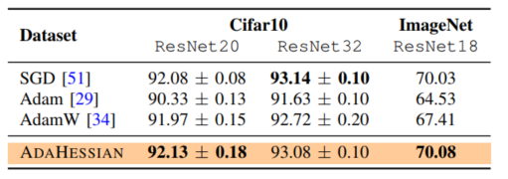
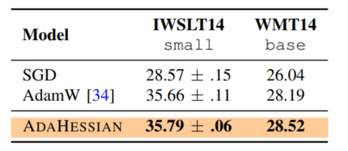
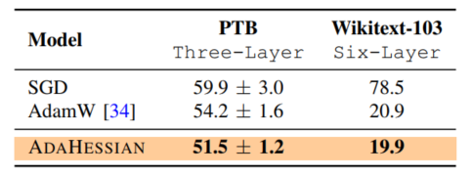
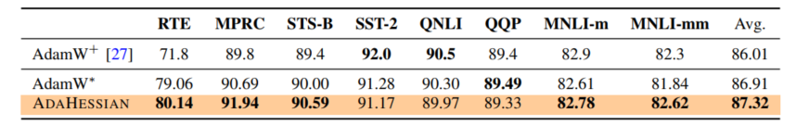
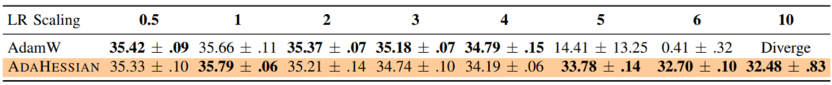
Results：performance
CV(Accuracy)
机器翻译(BLEU score)
Language Modeling(PPL)
NLU
推荐系统

Slide 11
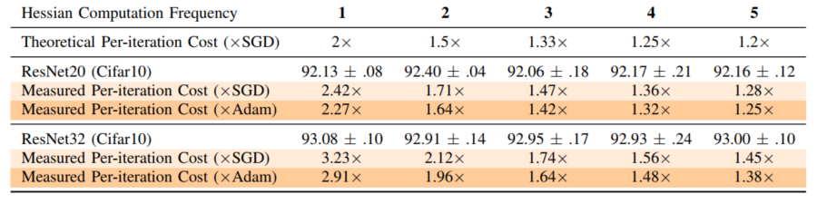
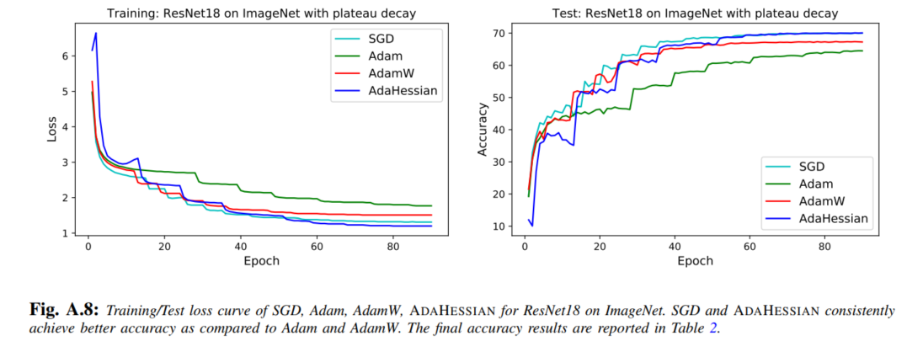
Result：Speed
训练时间更长，计算量增加一倍

